Slide 1
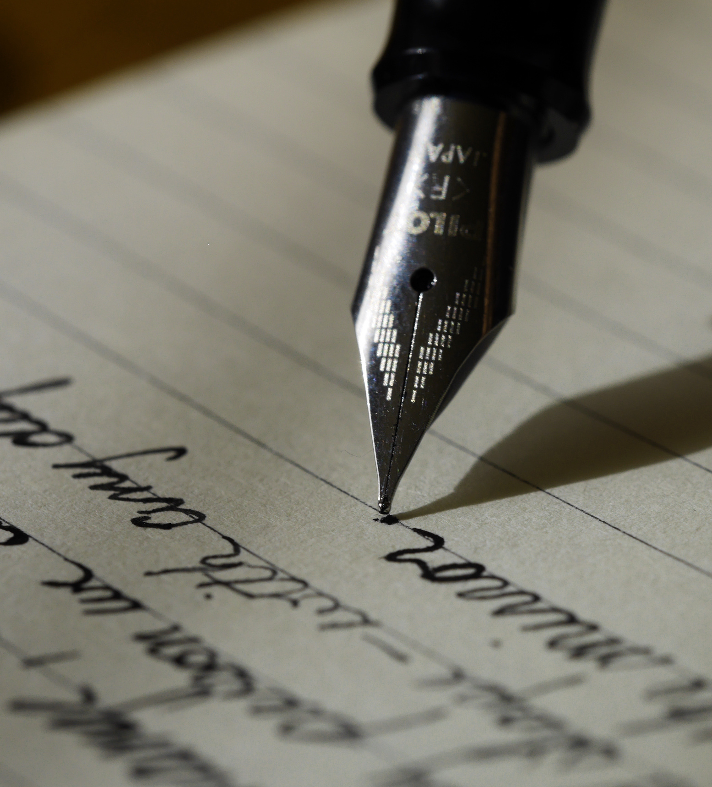
Constrained Writing
Constrained writing is a literary technique in which the writer must adhere to rules or restrictions that forbid certain elements or impose a pattern upon the writing. Many types of poetry are products of constrained writing.

Slide 2

Poetry and Constrained Writing
You are likely already familiar with many types of poems that are formed by their constraints. A haiku is the perfect example. What writing constraints are imposed upon the writing of haikus? What are some other examples of poems that are governed by restrictions?
Notes:
Students should explain that the syllable restrictions are the main constraint feature of the haiku poem. Sonnets and limericks are other great examples of poems that have restrictive characteristics via rhyme, meter, length, etc.

Slide 3
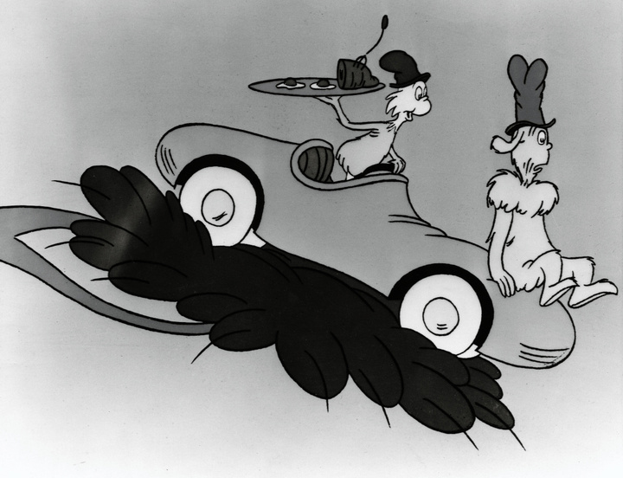
Avant-Garde Writing
Where constrained writing really gets interesting is beyond poetry. Traditional poetic patterns and constrictions have been around for a long time, but newer creative writing techniques have produced some revolutionary pieces of writing.
Dr. Seuss is well-know as a writer that employs restrictions to create interesting effects for the reader. The famous book Green Eggs and Ham was actually the product of a bet between Seuss and his publisher that he could not create a full book using only 50 unique words.
Notes:
Be sure that students are familiar with the term "avant-garde" which means "experimental" or "unorthodox."
You can tell your students that Dr. Seuss' The Cat in the Hat was born under similar circumstances. He was tasked with writing an interesting children's book using only 250 words that were deemed important for 1st graders to be able to recognize. His books became so popular because they were so different that earlier books designed for very young readers.

Slide 4

Working with Word Restrictions: the Six-Word Memoir
The origin of "Six-Word Memoir is thought to come from Earnest Hemingway. He was challenged to compose a story using only six words and came up with this:
For sale: baby shoes, never worn.
Notes:
Have students speculate on the meaning of Hemingway's six-word story. Challenge your students to write their own six-word memoir based upon a life event. Use the "Six-Word Memoir" handout for this activity. This is intended to be a quick, fun activity and you can have students start it in class and illustrate it for homework.

Slide 5

OuLiPo: Ouvroir de Littérature Potentielle
Translation: Workshop of Potential Literature
This is a group of writers founded in 1960 that consisted of French writers using constrained writing techniques to create written works that were nothing like anything one might typically find. Many writing constraints are attributed to this group and are referred to as "Oulipian Constraints."

Slide 6
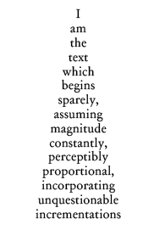
OuLiPo: The Snowball
The "Snowball" is a type of poem where each lines consists of only one word and each successive line is exactly one letter longer than the previous line. The example on the right is a snowball poem about a snowball poem!

Slide 7
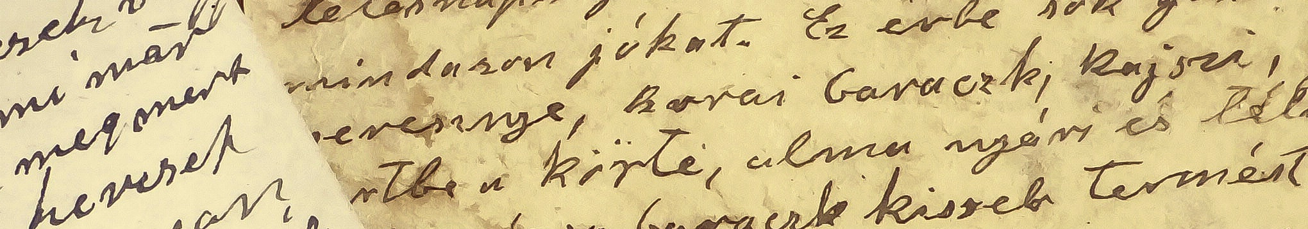
In groups, you will look at a writing sample and try to figure out what "odd" characteristic you see. Someone in each group should read the piece aloud as you try to find the applied constraint.
Notes:
Break your class into five groups- a group for each vowel. Do not give them any hint that this activity centers around vowels. It's interesting that it can actually take students a while to realize that their piece is written using only a single vowel. Pass out the Group Eunoia Excerpts face-down to each group. Tell them turn them over at the same time and see how long it takes for a group to figure it out. Do not move onto the next slide before your students have finished this part of the activity.

Slide 8
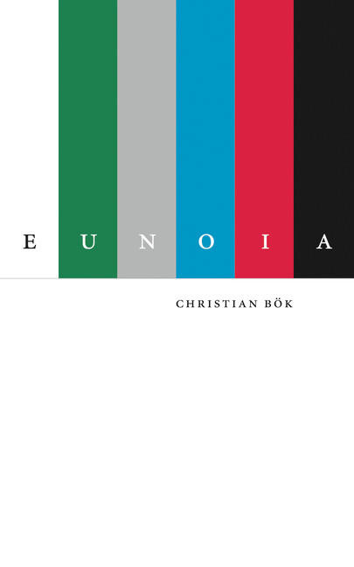
Eunoia by Christian Bök
These excerpts are taken from a five-chapter novel called Eunoia in which each chapter centers around a particular vowel. Bök maintains that each vowel has its own distinct personality, and it shows when this writing constraint, called univocalism, is applied. Notice the title of this book, Eunoia, contains one of each vowel. What is amazing about this book is that it actually tells a story and has several themes running throughout it.
Notes:
This book is worth having in your classroom if you teach creative writing!

Slide 9
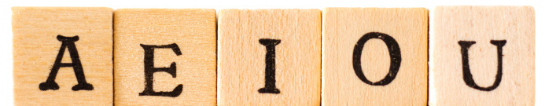
Constrained Writing: Univocalism
In your groups, you will be assigned a vowel that was not the one from your Eunoia excerpt. Write a five-sentence passage using words that only use your assigned vowel. To keep in line with the style of Christian Bök, you cannot use words with "y" because it has its own vowel sound that detracts from the sound of your assigned vowel. Your writing must be grammatically sound- it should not be a string of nonsense. Begin by making a list of words (and names) that contain only the selected vowel. Once you have a large list, begin constructing sentences.
Notes:
Pass out the Univocalism Planning Sheets to your groups. I assign a different vowel from the one in each group's excerpt just to prevent them from copying from the excerpt. Students should spend quite a bit of time compiling a list of words. This always proves to be a more difficult task than they realize since so many words contain multiple vowels.

Slide 10
Constrained Writing: Univocalism
Does each vowel seem to take on a personality of its own? What personality would you assign to each vowel?
Notes:
I like to have my students write their paragraphs on the board. I divide my board into five sections for this. We read each aloud and then discuss what feeling or personality each piece of writing has. Students usually find O to be "bubbly" or "loopy" for example. Often the word used to describe the personality of each letter often contains said vowel.

Slide 11
Why Is This Important?
This exercise demonstrates how placing restrictions or constraints on our writing can actually open up the doors to creativity. Specifically, univocalism teaches us that not only is word choice important, but letter choice can have a huge impact on the feel of our writing. Consider the value of each letter and sound as you read and write poetry and other works of creative writing.
Notes:
I remind my students of this thought as we move through our poetry unit and discuss word choice and sound devices such as assonance.

Slide 12


